Slide 1
First Rate Regulator Initiative
Council Workshop
5 June 2013
Nick Stace
RCVS Chief Executive
Anthony Roberts
Policy and Public Affairs Officer

Slide 2
Purpose
To benchmark where the RCVS currently sits in terms of regulatory effectiveness, and to develop plans to deliver improvements across the organisation during 2013 and beyond.

Slide 3
This presentation
Highlights from quantitative and qualitative research
Overview of best regulatory practice research
A brief summary of the FRR Report recommendations
A framework for discussion and ideas for a strategic plan

Slide 4
Recommendations
Based upon the four research studies and assessment of current RCVS practice.
Interviews and focus groups
Qualitative interviews with 47 individuals and organisations, which explored how the RCVS is perceived internally and by key external audiences.
Three focus groups with RCVS staff across nine different departments.
Telephone interviews with nine individuals whose complaints led to a disciplinary hearing.
Survey of complainants
Quantitative survey of 265 members of the public who complained about a veterinary surgeon or nurse during 2011 and 2012.
265 respondents (approx 18% response rate)
A total of 25 further letters and emails were received from those unwilling to complete the survey.
Best practice research
Desk research exploring best practice in professional regulation, drawing on experiences of nine health professional regulators, two legal services regulators, and four international veterinary regulators.
Survey of the professions
Quantitative survey of nearly 4,900 veterinary surgeons, veterinary nurses and practice managers.
Survey live for six-weeks and a response rate of around 20%.

Slide 5
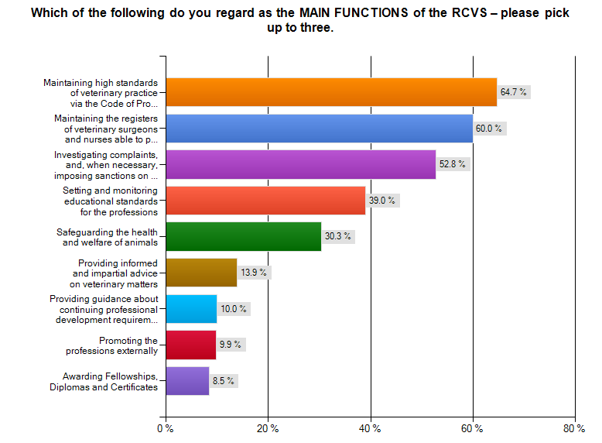
Survey of the professions
Q14. Base: all answering (4,244)

Slide 6
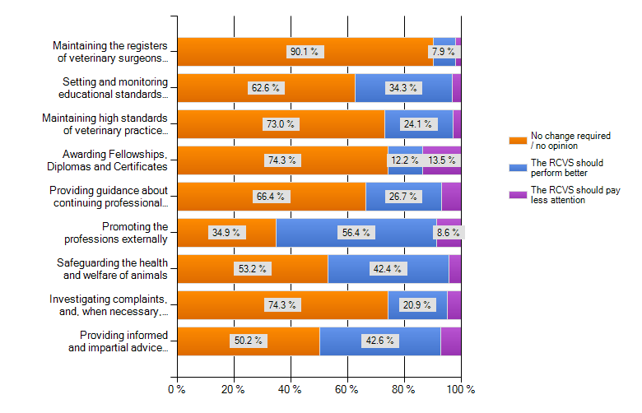
Areas where the RCVS could perform better
Q15. Base: all answering (4,059)

Slide 7
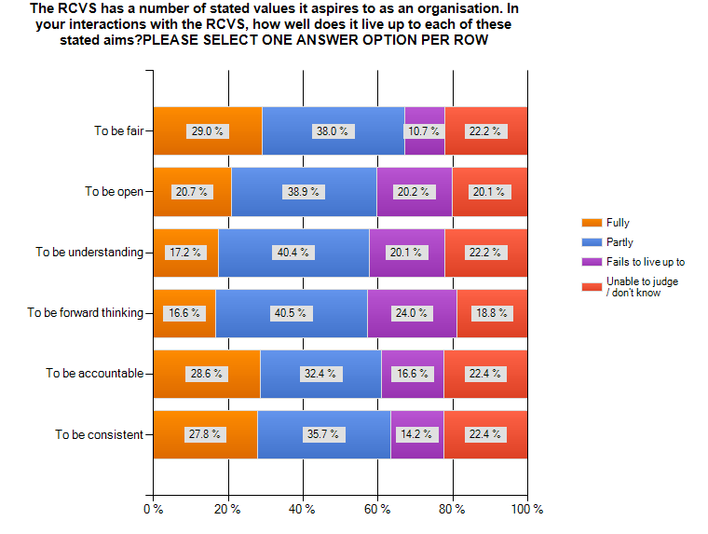
Most believe RCVS lives up to six stated values
However, 1 in 4 think the RCVS is NOT forward thinking, and 1 in 5 think it is NOT open or understanding
Q17. Base: all answering (3,942)

Slide 8
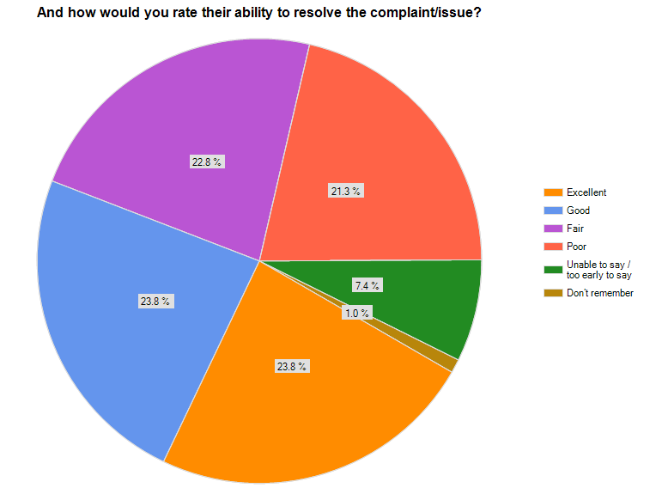
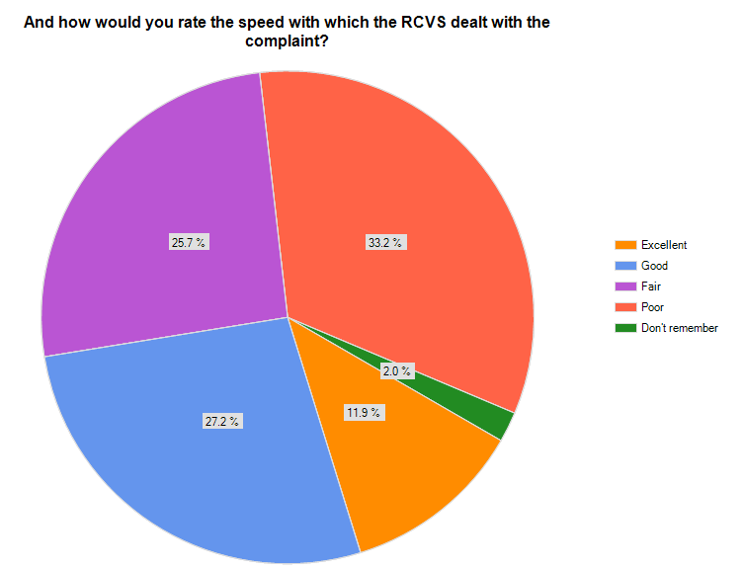
There are very mixed experiences of the RCVS reported from those about whom a complaint has been made
One third regard speed of handling as poor; 1 in 5 regard resolution ability as poor
Q20-21. Base: all complained against in last 2 years (202)

Slide 9
Example issues highlighted
I thought the final response to the complaint rather beat-about-the-bush. It left me feeling that the primary interest was in being seen to pursue a process so that all parties felt 'listened to' rather than a pursuit of the truth.
I found the whole process daunting. I was given little time to present my side of the situation whilst the RCVS was able to take as long as it wanted.
The RCVS dealt with the complaint and dismissed and then informed me. The letter was helpful, balanced, and well informed.
The RCVS was remote and gave the impression of favouring the complainant. Personal contact from an early stage to communicate the likely seriousness would be helpful.
Q23. Base: all complained against in last 2 years (202)

Slide 10
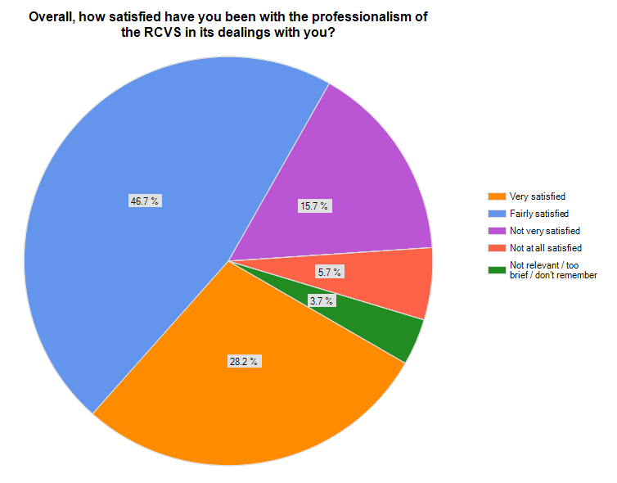
Customer service: overall satisfaction
Q31. Base: all contacting the RCVS in the last year or so (1,629)

Slide 11
Survey of profession: summary of key messages
The professions want the RCVS to perform better in a number of areas, especially:
  promoting the professions externally
  providing informed advice
  protecting animal welfare
The RCVS is not widely considered to be ‘in touch’ with clinical practice; Council is seen as ‘old school’
Staff are considered polite and professional, but often considered not to have the relevant information and knowledge to help
More than half use the website infrequently or not at all; those who do, rate it positively

Slide 12
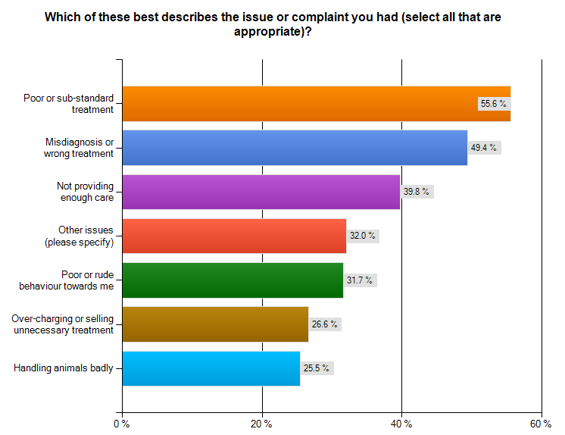
Complainants survey: reason for complaints
Most have complained about poor or wrong treatment, or about insufficient care
For 14% of respondents, their complaint to the RCVS was still open
Q4. Base: all answering (259)

Slide 13
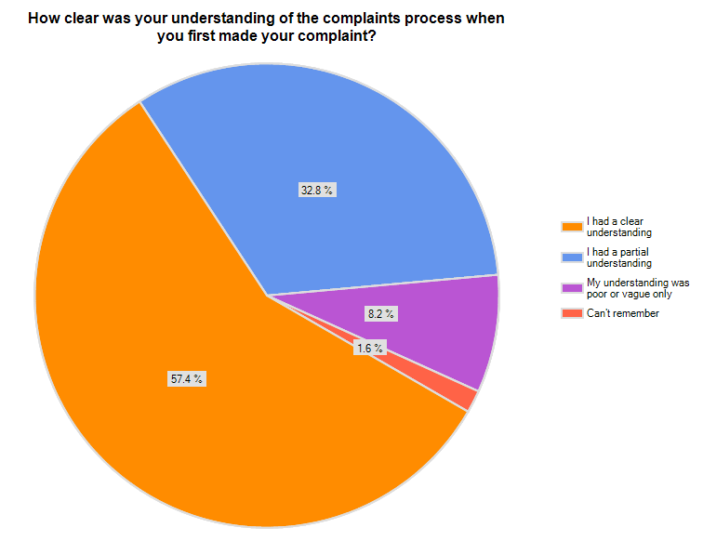
More than 40% of complainants had only a partial or poor understanding of the complaints process
Q5. Base: all answering (256)

Slide 14
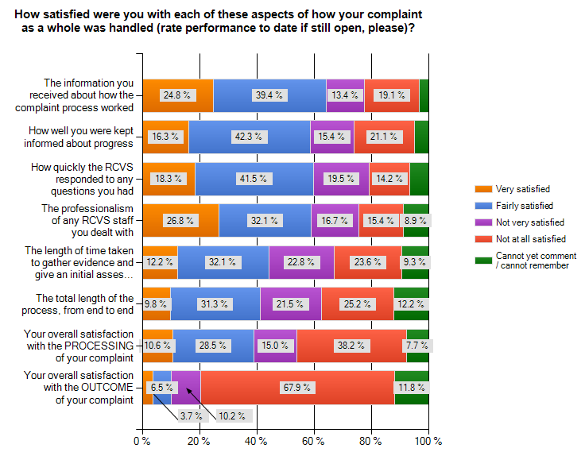
Complainants have mixed views about the process, but most dissatisfaction is with the outcome
Q16. Base: all answering (246)

Slide 15
I felt as though I was not taken seriously enough with the matters raised. Further investigations should have been carried out and more detail looked at.
It felt that the concerns raised in the complaint were disregarded and that RCVS was going through the motions...
It was difficult for the RCVS to give the outcome we were seeking because your brief is to identify and prosecute gross misconduct but not negligence.
Make further investigations and actually arrange to speak with the complainant to establish all the facts not just base the outcome on written information.

Slide 16
Complainants: key messages
Complainants feel that the system is biased
Not a proactive enough approach to dealing with problems with veterinary surgeons
Powers are considered too narrow
Complainants do not feel sufficiently listened to or supported – communication too technical
Need more thorough investigation – more visits
Swifter resolution of cases

Slide 17
Qualitative interviews
RCVS STAFF
RCVS COUNCIL MEMBERS
THE PROFESSION
STAKEHOLDERS
1 x group with Registration, Practice Standards & Education Departments
6 elected members
3 lay members
3 university-appointed members
10 veterinary surgeons
4 x small animal
3 x large animal
2 x mixed animal
1 x equine
Mix of urban & rural, small & large practices
British Veterinary Association (BVA)
British Veterinary Nursing Association (BVNA)
Society of Practising Veterinary Surgeons (SPVS)
Veterinary Medicines Directorate (VMD)
Veterinary Defence Society (VDS)
Veterinary Surgeons Health Support Programme (VSHSP)
Defra
Unite union
National Farmers Union (NFU)
Kennel Club
RSPCA
Action Group – Animals Deserve Better
1 x group with Professional Conduct, Corporate Services & Veterinary Nurses
VETERINARY NURSES COUNCIL MEMBERS
4 veterinary nurses
Mix of urban & rural
Mix of small & large animals
1 x group with Finance, Corporate Services, Communications & Executive Office
3 veterinary nurse members
1 veterinary surgeon member
1 lay member
4 practice managers
2 accredited & 2 non accredited

Slide 18
Stakeholder organisations
Great deal of progress has been made in recent years
RCVS has all the ‘ingredients’ of a first rate regulator
Legislative reform order strengthens impartiality,
but further change needed
Improvements could be made around:
  Openness and collaboration
  More proactive engagement
  Stronger focus on animal welfare
  Greater clarity sought over our roles
  Separation of functions (regulator and Royal College)

Slide 19
Stakeholder organisations
Regulation should come away from the Charter – as it confuses themselves as to what their job really is – and it confuses us sometimes too.
Really the role of the regulator is to safeguard the interests of the people who use the services of people who are on the register – but it comes across that their main interest is safeguarding members.
I’d like to see a clear idea developing about what the College’s role really is and then doing that well rather than fiddling around with some of the peripheral issues.
They need to look more in advance towards the demands that might be coming towards the profession – move the veterinary profession forward quicker. They need to be more forward focused.

Slide 20
VSs, VNs & PMs
Perceived as being a fair and respected regulator
Little enthusiasm for a move away from self-regulation
Legislative Reform Order is a positive step (mainly for public perception)
Somewhat confusing relationship with us
  Feared and respected as regulator
  Feel ownership, especially concerning how money is spent
  Some understanding that it’s hard for us to juggle the roles
Improvements could be made around
  Lack of engagement with the profession
I just see that we pay a lot of money to the RCVS & we get clobbered by them.
Large animal VS
They say they serve the general public but it’s the profession that pays for them.
Small animal VS

Slide 21
RCVS Council members
Council members believe they are discharging regulatory functions to a high standard
Appetite for change
Operational Board step in the right direction
Concerns around:
  Duality of role
  Size of the Council
  Age and gender of Council members
  Terms for Council members and President
  Balance of member type and selection of committee members

Slide 22
RCVS Council members 2
Opportunities for improvement include:
    Introducing a stronger structure to meetings, to support better adherence to meeting rules
    More formal induction for new members
    More pre-Council meetings

Slide 23
RCVS Council members
I think we could be a first-rate regulator if a lot of the minutiae of micro-managing was taken away from Council and committees.
Elected member
I think people shouldn’t stay 20 years on Council because there is a limit to how much you can contribute and you need to have a fresh intake of new blood. Elected member
Elected members feel they are representing the profession in a political kind of way. They are meant to be representative of the profession but not representing them – that’s an important distinction. Lay member
The profession should be very proud of the College. And the calibre of staff working at the College is excellent too. The Officer team also care passionately about the profession. Lay member

Slide 24
VN Council
Most feel that VN Council is well run and makes good decisions (even though decision-making powers are reliant on goodwill of RCVS Council)
Recent and upcoming changes viewed positively, namely:
    Accreditation of courses done by separate bodies
    Appointment of a new Education Subcommittee
    Separation of disciplinary process from VN Council
    Changes to when VN Council sits (not in busy Committee week)

Slide 25
VN Council 2
Areas for improvements:
    Greater communication and respect between the two Councils and within the RCVS
    Better understanding amongst public about the role of veterinary nurses
    Ensuring that RCVS’ core focus is the welfare of animals and the public
    Protecting the title of veterinary nurse (underway) to ensure that the profession is properly regulated

Slide 26
VN Council 3
Want to remain part of RCVS rather than become a separate entity as:
  VSs and VNs work as a team,
  Better for the public, and in animals’ interests
  Profession currently too small to have a separate VN body
However, would like the VN Council Chair to be a member of main Council
I would like to see RCVS keeping the VNs under their wing. The nurses could if they chose set up another organisation but I think that would be quite foolish for a variety of reasons, one of which is financial.
It is disappointing that we don’t have a vote (on main Council) – we are a team and we work shoulder to shoulder and side by side.

Slide 27
RCVS staff
    Good place to work
    CEO listening to staff and addressing concerns
    Proud of work as a regulator
    Some feel under-resourced and complain about a lack of training and progression
    Key priorities for staff:
      Resolve issues with the database urgently
      Invest in more staff to ensure standards are maintained
      Increase staff motivation (through training courses, internal promotions, positive feedback and better working relationships with Council)
      Become more outward-facing, including clarifying the dual role of the RCVS to the public and the profession

Slide 28
Qualitative: key messages
    Optimism for the future – change is welcomed; high expectations of new CEO
    RCVS is generally perceived as a good, fair and just regulator
    The LRO is positive, but further reform may be required
    The ability to be both regulator and Royal College is a source of concern to external stakeholders
    Communication with the professions has improved, but lack of proactive engagement an ongoing issue
    Need to do more to show RCVS is open, transparent and outward-facing

Slide 29
Key messages 2
RCVS needs to demonstrate it is an up-to-date organisation and not an ‘old-boys club’
A greater focus on animal welfare and engagement with the public is a recurring theme
Clarify the position of veterinary nursing within the RCVS
Improve the efficiency of RCVS Council meetings, clarify the role of Council members, and review the structure of Council and its committees
Improving internal communications, increasing resourcing, and better IT systems are considered priorities by RCVS staff

Slide 30
Disciplinary interviews
Telephone interviews with 9 people (relating to 8 cases) whose complaint about a vet had reached a DC over the last two years
Interviews were an average of 25 minutes, held during February and March 2013
Of the 9 complainants, 3 were veterinary surgeons and 1 was a veterinary nurse.

Slide 31
Key messages
The time it takes for a case to reach a disciplinary hearing is the main concern
Most acknowledged the thoroughness of the process
Interviewees perceive that the RCVS is overly lenient with ‘defendants’
Some questioned the rigour with which the RCVS pursues a case
Lack of communication is an issue both during and after a case
In the main the way hearings were managed, RCVS staff and the panels were all thought to be extremely professional

Slide 32
Quotes from interviewees
It was two years of hell…far too long…felt like my practice was the defendant, not the nurse.
They take complaints seriously, but don’t have robust (enough) processes to make sure they are concluded satisfactorily.
(We) did not feel that the RCVS did a very good job at all…You fail to see how the panel came up with the (verdict) they did…it’s the difference between ‘in all probability’ and ‘absolute certainty’’ .
I think they did a terrific job…they communicated with us very well…I can’t think of any improvements.

Slide 33
Best regulatory practice: governance
Of the 15 regulators:
7-14 member governing bodies – direction of travel is 8-12
At least parity of lay/professional members (except international veterinary regulators)
All but one have separated regulation from representation, or delegated professional role elsewhere
Most UK regulators are London based – see GMC for learning about establishing presence regionally and in the four countries

Slide 34
Best regulatory practice: standards and guidance
Regulators tend to have a single code covering multiple professions. Specificity achieved by having additional guidance for each profession (eg HCPC)
General Optical Council has two codes – one for individual registrants and one for business registrants
Innovative practice: GMC has developed range of learning materials to help doctors apply standards
Law Commission proposal to distinguish between mandatory and optional guidance met with a mixed response

Slide 35
Best regulatory practice: registration
Registers range from 2,000 to over 670,000 (international veterinary regulators 2,400-3,000)
To register: evidence of good health, good character, qualifications, professional indemnity (some also ask for police check and proof of identity)
Key Performance Indicators for registration departments
Greater use of e-billing and online accounts for registrants
Fees vary widely: from £76 (new UK graduates registering with HCPC) to £800 (chiropractors) and £1,000 (some barristers). International veterinary regulators $435 (Australia $), $440 (New Zealand $), around $1,100 (Canada – complex fees structure)
Some have lower fee rates for first year; General Optical Council and Bar Standards Council reduce fees for registrants on low incomes

Slide 36
Best regulatory practice:
Education and training
Shift towards more outcome-focused, risk-based QA
Lay people (and sometimes students) key part of QA visit team and some seek views from public on QA visits
CPD requirements vary (international veterinary regulators tend to require 20 hours a year (over 2 or 3 year cycles). Some require % hours on learning with other professionals
Online recording of CPD increasingly common and many are reviewing CPD requirements and processes

Slide 37
Best regulatory practice: handling complaints
Wide variations in numbers of complaints and source (GMC 8,781 concerns in 2011, 23% year-on-year increase and greatest increase from public)
Timeframes for responding to complaints about services of regulator, but not for responding to complaints about registrants
Different approaches to investigation – e.g. GMC refers ‘Stream 2’ complaints to employer
Some responded to gaps in redress arrangements – GDC funds service for complaints about private treatment (most resolved <week, annual cost c.£500k); GOC contracts with Optical Consumer Complaints Service
Emphasis on improving way explain processes/outcomes (e.g. GMC pilot meeting scheme)

Slide 38
Best regulatory practice: fitness to practise
Main statutory grounds for impairment: misconduct, deficient performance, adverse health, criminal convictions/cautions
Moves to make processes swifter, more streamlined and more proportionate
A number of regulators using KPIs to drive performance
Drive for independent adjudication
Direction of travel:
  At investigation stage: warnings, interim orders, undertakings, voluntary erasure, and advice
  At adjudication: warnings, conditions of practice, suspension, striking off, and fines

Slide 39
Best regulatory practice: engaging stakeholders
Engagement with registrants tends be through e-newsletters and regional events.
Some have panels with members of public (GMC, GOsC & GOC) and conduct surveys of public perceptions (GOsC)
Increasing use of social media
Emphasis on increasing engagement with employers (GMC set up Employer Liaison Service)
International veterinary regulators – strong emphasis on animal welfare and also registrant health and work/life balance

Slide 40
Sally Williams’ recommendations
Governance
6 recommendations
Standards & guidance
4 recs.
Registration
5 recs.
Education & training
3 recs.
Fitness to practise
6 recs.
24 recommendations made over five core areas

Slide 41
Responding to the report
Officers workshop 22 April, to:
  Consider findings and recommendations
  Prioritise the recommendations
  Develop a plan for implementing reform
  Provide a framework for discussion by Council
  Propose initial ideas for the RCVS strategic plan

Slide 42
Identity
A clear purpose and vision along the lines of ‘setting, upholding and raising veterinary standards’, should be put at the heart our identity
Demonstrate a proactive approach to regulation, backed by an engagement strategy
The status of veterinary nurses within the RCVS should be better defined and articulated
The true ‘Royal College’ role of the RCVS should be defined and consideration given to its expansion
A strategic plan is required to outline our future direction, organisational goals and areas for improvement

Slide 43
Service
Performance targets to ensure customer focus.
Greater flexibility in communication
Introduce a ‘Complainants’ Charter’
Support of those involved in complaints should be strengthened and a more compassionate approach adopted
Reduce time taken for complaint to get to Disciplinary Committee
A more proactive approach to fitness to practise and be willing to investigate where an allegation, but no formal complaint, exists
Advice and support provided to professions should be reviewed and strengthened

Slide 44
Evolution
Working Party to consider ‘Royal College’ role
Review Royal Charter
Civil Standard of Proof for DC
Consider need for additional sanctions and powers
Mechanisms for consumer redress
Governance structures
Agree framework with Government and stakeholders regarding wider legislative reforms

Slide 45
Summary
Identity
Clarify and articulate role and function
Greater independence for our regulatory functions
Defining and expanding our role as a Royal College
Service
Making it easy to interact with us
Improving communication
Speeding up complaints handling
Evolution
Governance
Addressing consumer redress
Keeping ahead of best practice developments

Slide 46
Today’s Workshop
Questions on research, findings and recommendations
15:30: Breakout groups (closed session) to discuss findings and recommendations
16:30-17:15: Reports from breakout groups (open session)

